Slide 1
Introduction
Notes:
Welcome to ECE344

Slide 2
About the Instructor
Instructor – Ashvin Goel
Contact information
Email: ashvin@eecg.toronto.edu
Good way to contact me directly
Webpage: http://www.eecg.toronto.edu/~ashvin
Office: SF2001B
Office Hours: Mon, 12-2pm
Research Interests
Operating systems, storage systems, cloud systems
Software reliability

Slide 3
What is an Operating System?
Notes:
Discuss what is an OS
What are the h/w guys good at: living in the physical world: concurrent h/w, low power, handling external events, timing, speed
What are the s/w guys good at: living in the virtual world: data structures, algorithms, flexibility, extensibility, modularity, large scale systems
Both are striving at making the system work correctly and efficiently, but there is a big disconnect

Slide 4
What is an Operating System?
Layer of software between hardware and applications
Application is usually dedicated to a single task
OS serves all applications, also called systems software
Program1
Program2
UI
Background tasks
Lib
Lib
Lib
Lib
OS Kernel
Hardware
Notes:
Often, when people refer to OS, they mean the OS distribution, which includes the OS kernel and various libraries that are bundled with the kernel. In this course, we will focus on the OS kernel, which we will call the OS or kernel.

Slide 5
What does an Operating System do?
OS manages h/w resources
Allows programs to interact with h/w devices
CPU, memory, disk, graphics card, co-processors, etc., on desktops, phones, routers …
Provides simpler interface to devices (e.g., access disk as files)
What problems occur otherwise?
Allows running many programs at the same time
Allows programs to share CPU, memory
Isolates applications from each other
What problems occur otherwise?
Isolates itself from applications
What problems occur otherwise?
Notes:
Simpler interface: What problems occur otherwise?
Applications have to be written to specific h/w, program devices directly
- Load device command codes into device registers
- Handle initialization, recalibration, sensing, timing etc.
- Understand physical characteristics and layout
- Control motors
- Interpret return codes … etc
Think about what happens if you change the disk, from one manufacturer to another
Isolates applications: what problems occur otherwise?
- Applications can affect each other, write to each other’s memory (e.g., display), disk files, corrupt n/w packets
- Early versions of DOS/Windows provided no isolation, hence considered unreliable
Isolates itself: what problems occur otherwise?
Applications could corrupt OS, in which case, the OS would not provide isolation to applications

Slide 6
Aren’t Operating Systems Dead?
The OS I use has already been written, I doubt it will be my job to write another one
Haven’t OS developers figured everything already?
What more is there to do?
Why is this a core course?
OS sounds cool
Department doesn’t know better
Prof wants to keep his job
I have no idea

Slide 7
Why Study Operating Systems?
Studying OS design IS studying design of large software systems … its fun too?
OS hacking will make you a better programmer/thinker
OS is really large (Windows is 50 million lines+)
OS manages concurrency
Concurrency leads to interesting programming challenges
Interesting challenges can lead to deep thoughts, wisdom?
OS manages raw hardware
Programming raw hardware is challenging: timing dependent behavior, undocumented behavior, h/w bugs
OS must be efficient
Applications can use resources maximally
OS fails ⇒ machine fails
Basis of system security, helps focus on reliability, availability

Slide 8
Why Won’t Operating Systems Go Away?
Consider the design of MP3 player
Involves many OS issues: OS implements file system for storing music files, reads music from disc and buffers it in memory, controls volume, display, wireless network access, communication with PC
Operating system ideas applicable to all large application software … why?
Virtualization software (e.g., vmware, kvm), manages virtual machine “hardware”
Batch processing software (e.g., Hadoop) manages cluster
Cloud software (e.g., Amazon S3, Google drive) manages geographically distributed hardware
Web browser manages what?
Notes:
Why are OS ideas applicable: because all large application software manage resources
Web browser manages web sites

Slide 9
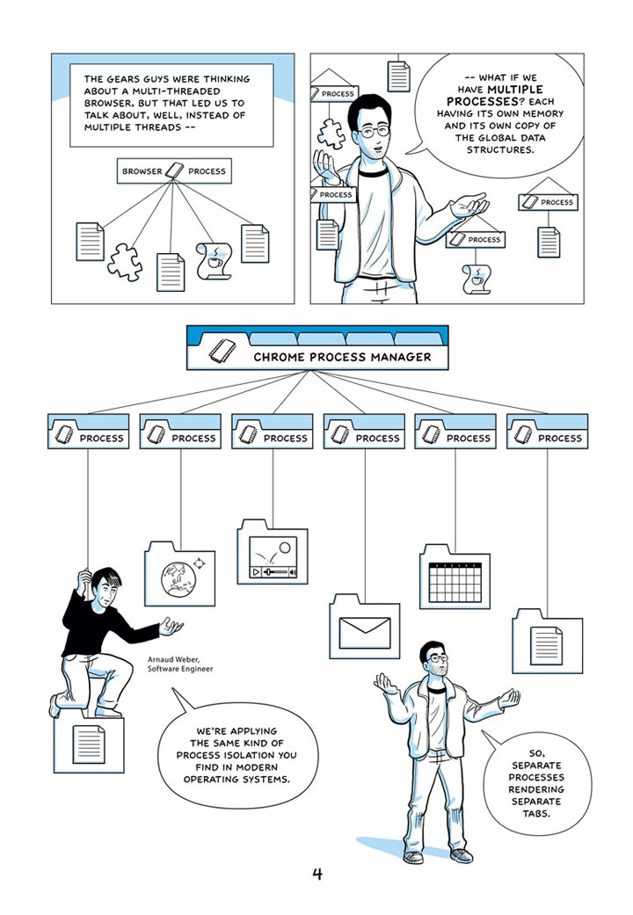

Slide 10
OS in the News
Much work being driven by mobile hardware
Samsung's Tizen 3.0 to take on Android and iOS starting in September (pcworld, Apr 28, 2016)
Samsung wants Tizen to become as big a brand name as Google’s Android and Apple’s iOS
Tizen 3.0 designed for wearables, in-car entertainment systems, drones, TVs, and virtual reality headsets
Google is developing an OS called “Fuchsia,” runs on All the Things (androidpolice, Aug 12, 2016)
Google may try to unify Chrome OS and Android
Fuchsia's kernel, known as Magenta, is designed to work across a wide range of devices—from small "embedded devices" all the way up to laptops and desktops

Slide 11
Goals of the Course
Learn about operating systems
Understand the principles behind the design of an OS
Understand the requirements, and challenges
Space of possible solutions
Build simple software that helps clarify OS concepts
Real systems are more difficult to build than to explain
The devil is often in the details
Other benefits
Gain significant implementation and debugging experience
Learn to use software management tools

Slide 12
Course Contents
Introduction to OS concepts
Threads and processes
Synchronization and concurrency
Memory management, virtual memory
Disk management and file systems
Time permitting
Intro to cloud computing
Atomicity and consistency
Virtualization

Slide 13
Lab Assignments
There will be 6 labs in the course
Labs will focus on learning OS concepts
Lab 1: Review of C, simple data structures
Lab 2: Cooperative Threads
Lab 3: Preemptive Threads (builds on Lab 2)
Lab 4: Concurrent Web Server
Lab 5: Caching Web Server (builds on Lab 4)
Lab 6: File Systems

Slide 14
What to Expect From Lab Assignments
Expect to spend a lot of time on the lab assignments
The labs give specifications, not implementations
Allows for imagination
Allows for errors and frustration
It will be good to think of your design, before you code
Assume that you will do the design/coding outside lab hours
Use the lab to ask questions from TAs
You will work individually for the lab assignments
Can’t complain about partner’s inactivity!
Notes:
14

Slide 15
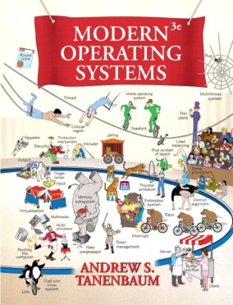
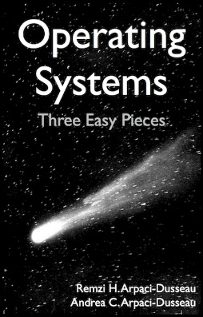
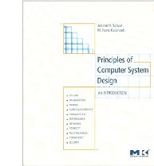
Suggested Textbooks
Modern Operating Systems, 3nd Edition
A. Tannenbaum
Operating Systems: Three Easy Pieces
Remzi and Andrea Arpaci-Dusseau
http://pages.cs.wisc.edu/~remzi/OSTEP/
Principles of Computer System Design
J. Saltzer, M. Frans Kaashoek

Slide 16
Class Resources
Class web site available from instructor’s home page
http://www.eecg.toronto.edu/~ashvin/courses/ece344/current
Provides course outline, instructor’s lecture notes, lab info
Piazza web site
Announcements
Discussion forum
UG machines
Code for labs available under /cad2/ece344f/src
Past exams available under /cad2/ece344f/exams
UoT Portal
Grades

Slide 17
Grading
Labs - 25%
Mid-term - 25%
Final - 50%
Policies
No extensions to deadlines
Questions should be addressed on Piazza web site
Read course webpage

Slide 18
Ethics and Engineering
From the Academic Integrity Policy document:
What if I didn't know I was cheating?
“You may be sanctioned for having committed an offence not only if you have intentionally committed it, but also if you ought to have known that you were committing an offence. Ignorance of the rules does not excuse cheating.”

Slide 19
Invalid Reasons
I gave the other group my code because they really needed help and I was sick at home. I told them not to copy my code.
You *ought to have known* that they could commit an offense, and thus you would be a party to the offense.
I left my USB stick in the lab computers and went to the washroom. The other group must have taken the stick, copied code, and returned the stick to the computer before I came back.
You *ought to have known* that someone could take your code, and thus you could be a party to the offense.
I was working all night before the lab deadline, and my code was not working fully, and I was so tired that I lost my judgment, and ended up copying code.
I heard that other students had raised their mark on the tester by copying code, or by subverting the marker, and I was really mad that others would get a free mark. I had worked very hard and I really wanted to make my work count.
I copied code from the Internet and I did clearly state in my code that the code was copied.

Slide 20
About the Instructor
Instructor – Ashvin Goel
Contact information
Email: ashvin@eecg.toronto.edu
Good way to contact me
Webpage: http://www.eecg.toronto.edu/~ashvin
Office: SF2001B
Office Hours: Mon, 12-2pm

